Slide 1
ECE282
IOT WITH NODEMCU

Slide 2
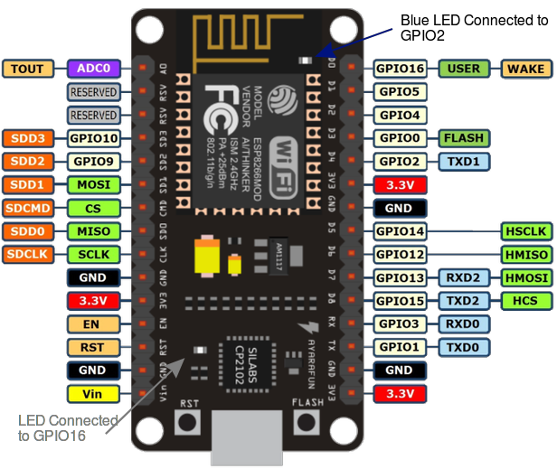
Node MCU Pin Configuration

Slide 3
Getting Started with Node MCU using Arduino IDE
Introduction
# NodeMCU is Lua based firmware of ESP8266. Generally, ESPlorer IDE is referred for writing Lua scripts for NodeMCU. It requires to get familiar with ESPlorer IDE and Lua scripting language.
#There is another way of developing NodeMCU with a well-known IDE i.e. Arduino IDE. We can also develop NodeMCU applications using Arduino development environment. This makes things easy for Arduino developers than learning new language and IDE for NodeMCU.

Slide 4
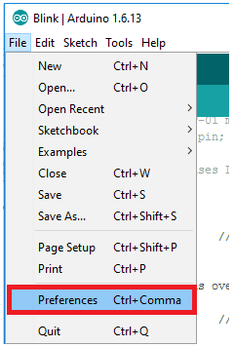
Let’s see about setting up Arduino IDE with NodeMCU.
First Download Arduino IDE (version 1.6+) https://www.arduino.cc/en/Main/Software
Open Arduino IDE and Go to
File -> Preference.

Slide 5
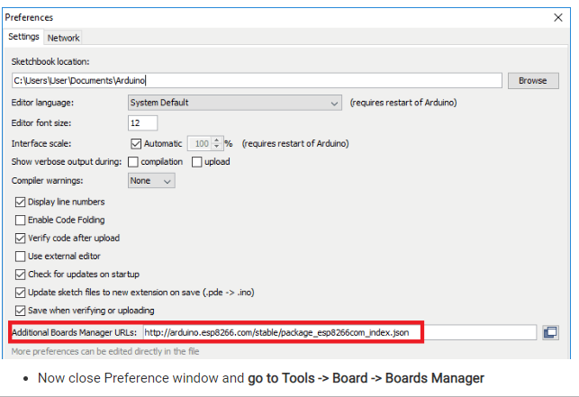
Now on Preference window, Enter below link in Additional Boards Manager URLs

Slide 6
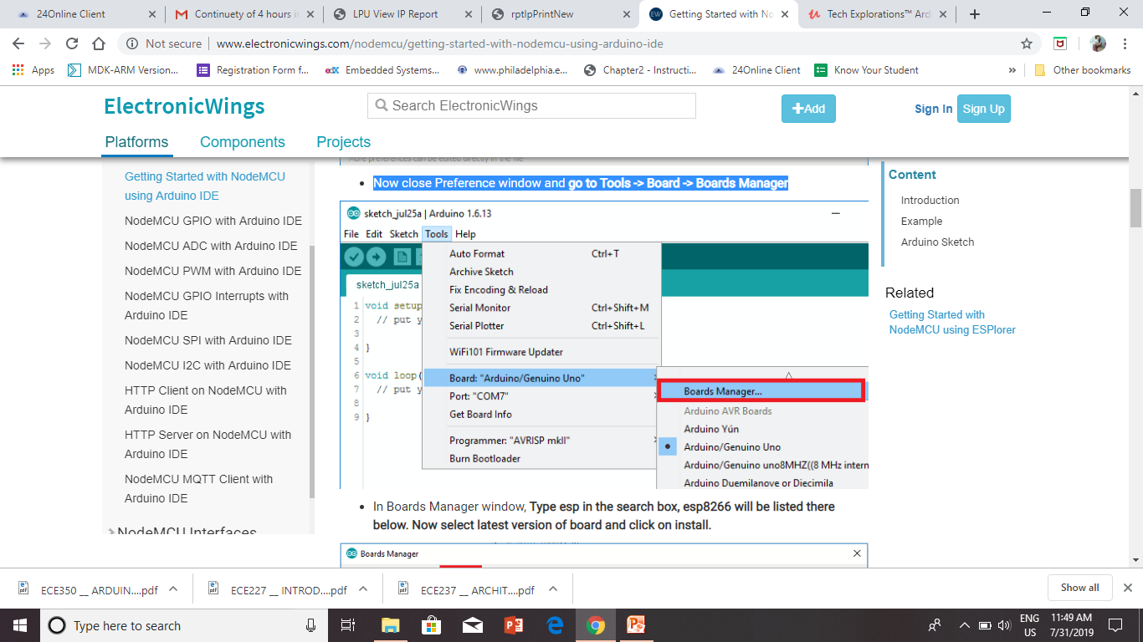
Now close Preference window and go to Tools -> Board -> Boards Manager

Slide 7
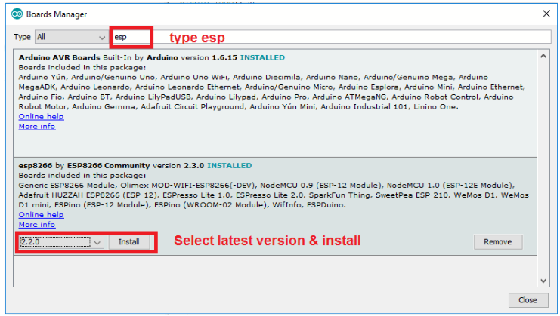
In Boards Manager window, Type esp in the search box, esp8266 will be listed there below. Now select latest version of board and click on install.

Slide 8
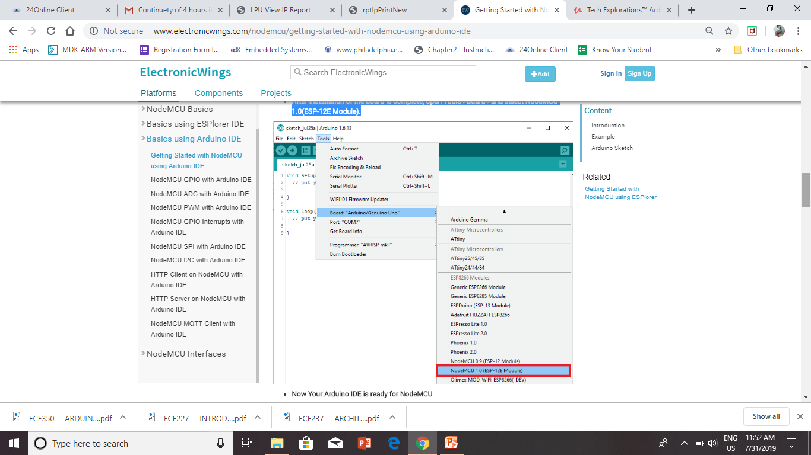
After installation of the board is complete, open Tools->Board->and select NodeMCU 1.0(ESP-12E Module).

Slide 9
http://arduino.esp8266.com/stable/package_esp8266com_index.json

Slide 10
Now Your Arduino IDE is ready for NodeMCU
Example
Let’s see how to write simple serial print sketch using Arduino IDE for NodeMCU.
First connect NodeMCU Development Kit with PC as shown in below figure.

Slide 11
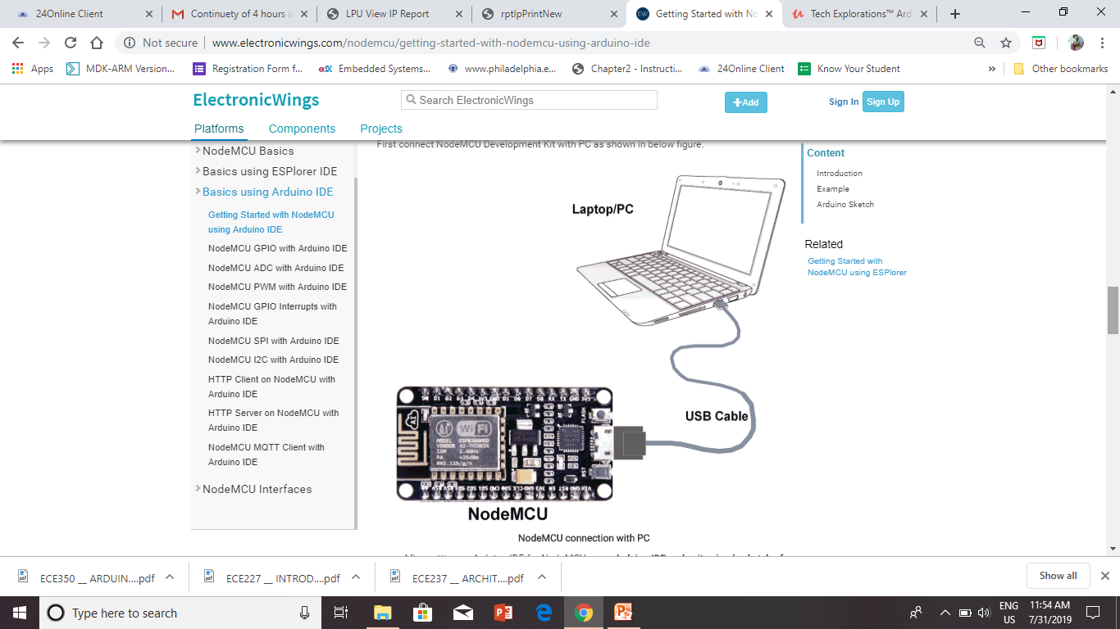

Slide 12
Node-MCU pin details
The NodeMCU ESP8266 development board comes with the ESP-12E module containing ESP8266 chip having Tensilica Xtensa 32-bit LX106 RISC microcontroller.
This microcontroller supports RTOS and operates at 80MHz to 160 MHz adjustable clock frequency.
NodeMCU has 128 KB RAM and 4MB of Flash memory to store data and programs.
Its high processing power with in-built Wi-Fi / Bluetooth and Deep Sleep Operating features make it ideal for IoT projects.

Slide 13
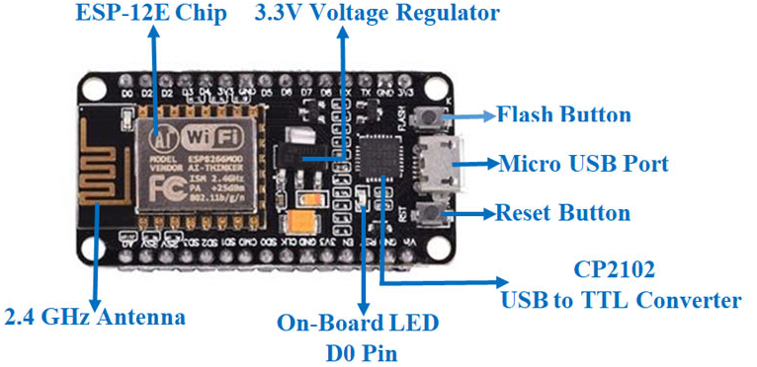
NodeMCU can be powered using Micro USB jack and VIN pin (External Supply Pin). It supports UART, SPI, and I2C interface.

Slide 14
NodeMCU ESP8266 Specifications & Features
Microcontroller: Tensilica 32-bit RISC CPU Xtensa LX106
Operating Voltage: 3.3V
Input Voltage: 7-12V
Digital I/O Pins (DIO): 16
Analog Input Pins (ADC): 1
UARTs: 1
SPIs: 1
I2Cs: 1
Flash Memory: 4 MB
SRAM: 64 KB
Clock Speed: 80 MHz
USB-TTL based on CP2102 is included onboard, Enabling Plug n Play
PCB Antenna
Small Sized module to fit smartly inside your IoT projects

Slide 15
NodeMCU Development Board Pinout Configuration
Pin Category | Name | Description
Power | Micro-USB, 3.3V, GND, Vin | Micro-USB: NodeMCU can be powered through the USB port 3.3V: Regulated 3.3V can be supplied to this pin to power the board GND: Ground pins Vin: External Power Supply
Control Pins | EN, RST | The pin and the button resets the microcontroller
Analog Pin | A0 | Used to measure analog voltage in the range of 0-3.3V
GPIO Pins | GPIO1 to GPIO16 | NodeMCU has 16 general purpose input-output pins on its board
SPI Pins | SD1, CMD, SD0, CLK | NodeMCU has four pins available for SPI communication.

Slide 16
UART Pins | TXD0, RXD0, TXD2, RXD2 | NodeMCU has two UART interfaces, UART0 (RXD0 & TXD0) and UART1 (RXD1 & TXD1). UART1 is used to upload the firmware/program.
I2C Pins |  | NodeMCU has I2C functionality support but due to the internal functionality of these pins, you have to find which pin is I2C.

Slide 17
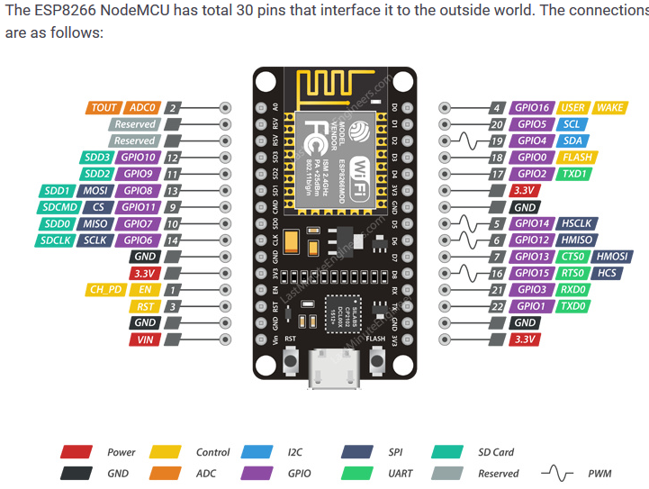
PIN Mapping

Slide 18
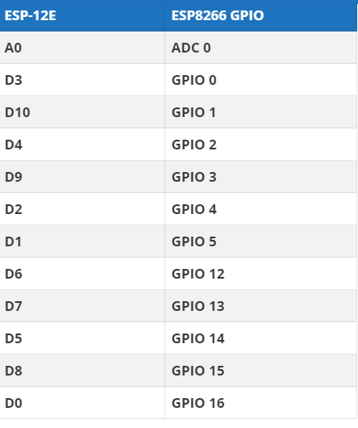

Slide 19
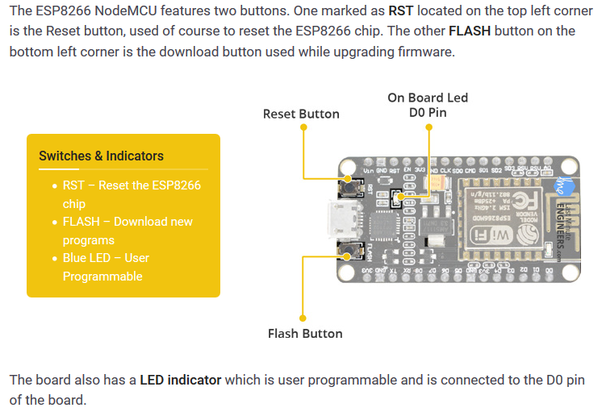
On-board Switches & LED Indicator

Slide 20
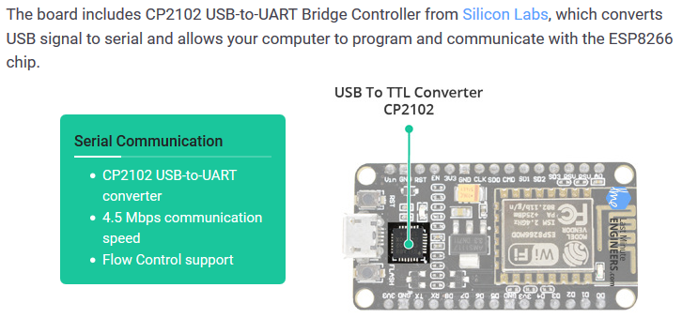
Serial Communication

Slide 21
Serial Communication
You can use the Arduino IDE environment’s built-in serial monitor to communicate with an ESP board.
Click the Tools>>Serial monitor button in the toolbar and select the same baud rate used in the call to begin().

Slide 22
commonly used serial commands
Serial.begin(9600);
Serial.print(); and Serial.println(): Serial.print prints text on same line. Seial.println puts carriage return at the end of line.
Serial.write();
Serial.available();
Serial.read();

Slide 23
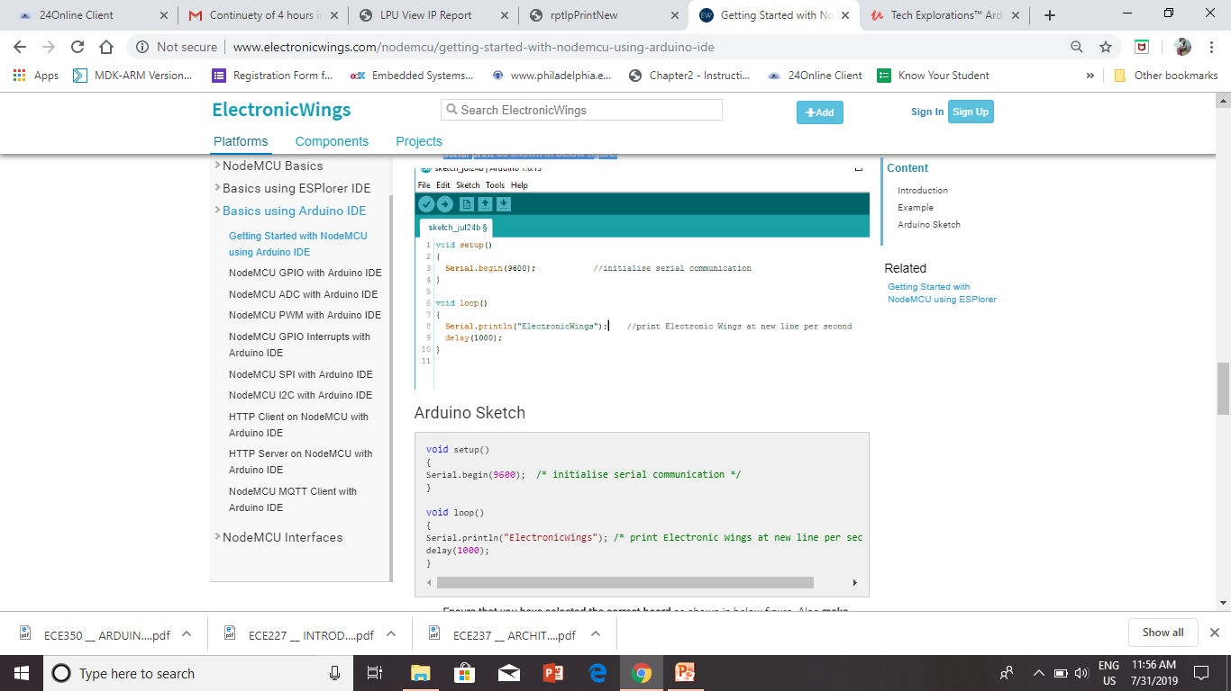
After setting up Arduino IDE for NodeMCU, open Arduino IDE and write simple sketch of serial print as shown in below figure.

Slide 24
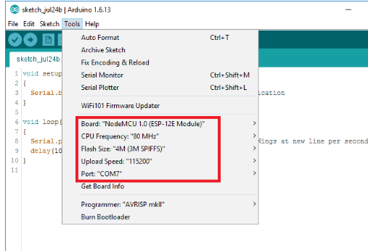
Ensure that you have selected the correct board as shown in below figure. Also make sure that you have selected the appropriate COM port.

Slide 25
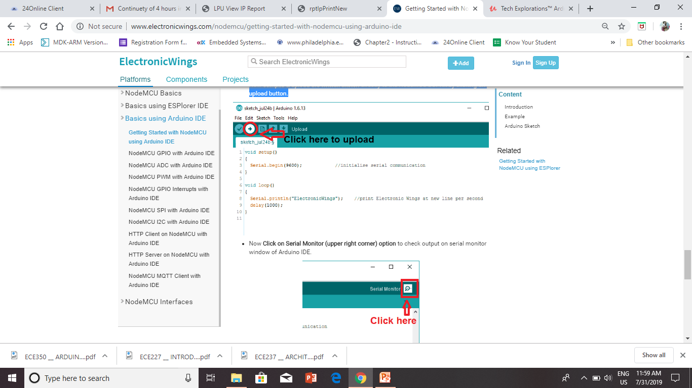
Now compile & upload the written sketch directly to the NodeMCU Dev Kit by clicking on upload button.

Slide 26
Practice programs
P1: Print Hello Word and Your name on Serial monitor?
P2: Print decimal numbers in BIN, OCTAL, DECIMAL and HEX-DECIMAL number system?

Slide 27
#define LED D1 // Led in NodeMCU at pin GPIO16 (D0).
void setup() {
pinMode(LED, OUTPUT); // set the digital pin as output.
}
void loop() {
digitalWrite(LED, HIGH);// turn the LED off.(Note that LOW is the voltage level but actually
//the LED is on; this is because it is acive low on the ESP8266.
delay(1000); // wait for 1 second.
digitalWrite(LED, LOW); // turn the LED on.
delay(1000); // wait for 1 second.
}

Slide 28
Ans:
Serial.print(78, BIN) gives “1001110”
Serial.print(78, OCT) gives “116”
Serial.print(78, DEC) gives “78”
Serial.print(78, HEX) gives “4E”
Serial.println(1.23456, 0) gives “1”
Serial.println(1.23456, 2) gives “1.23”
Serial.println(1.23456, 4) gives “1.2346”

Slide 29
Practice Program
1. LED blinking without/with Switch
2. LED blinking rate with Potentiometer

Slide 30
GPIO Input Example:
int ledpin = 5; // D1(gpio5) int button = 4; //D2(gpio4)
int buttonState=0;
void setup() {
pinMode(ledpin, OUTPUT);
pinMode(button, INPUT);
}
void loop() {
buttonState=digitalRead(button); // put your main code here, to run repeatedly:
if (buttonState == 1)
{
digitalWrite (ledpin, HIGH);
delay(200);
}
if (buttonState==0)
{
digitalWrite(ledpin, LOW);
delay(200);
}
}

Slide 31
Video link
https://www.youtube.com/watch?v=9VEpZlkN0r0
https://www.youtube.com/watch?v=HBSH_x6J1lY

Slide 32
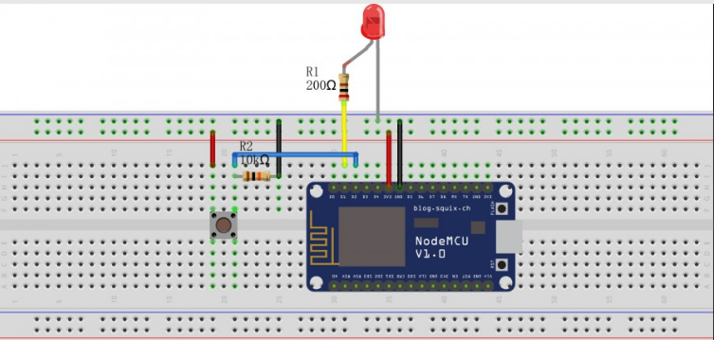

Slide 33
GPIO Output Example:
void setup() {
pinMode(LED_BUILTIN, OUTPUT);
}
void loop() {
digitalWrite(LED_BUILTIN, LOW);
delay(1000); // Wait for a second
digitalWrite(LED_BUILTIN, HIGH); // Turn the LED off by making the voltage HIGH
delay(2000); // Wait for two seconds (to demonstrate the active low LED)
}

Slide 34
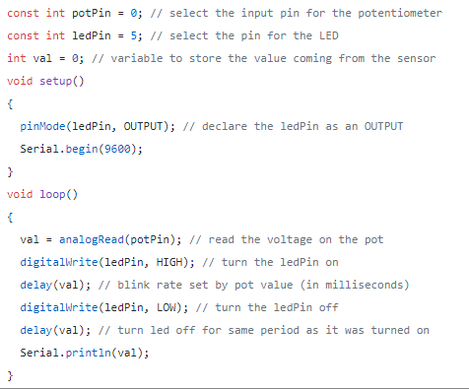
Code for potentiometer led blink

Slide 35
